Slide 1
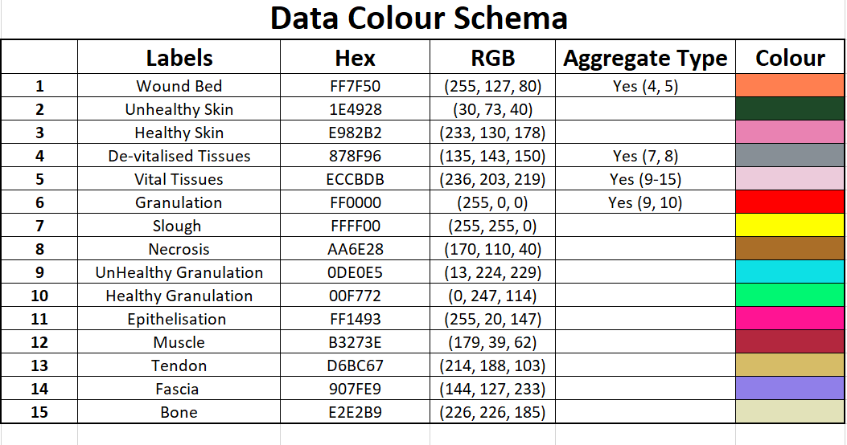

Slide 2
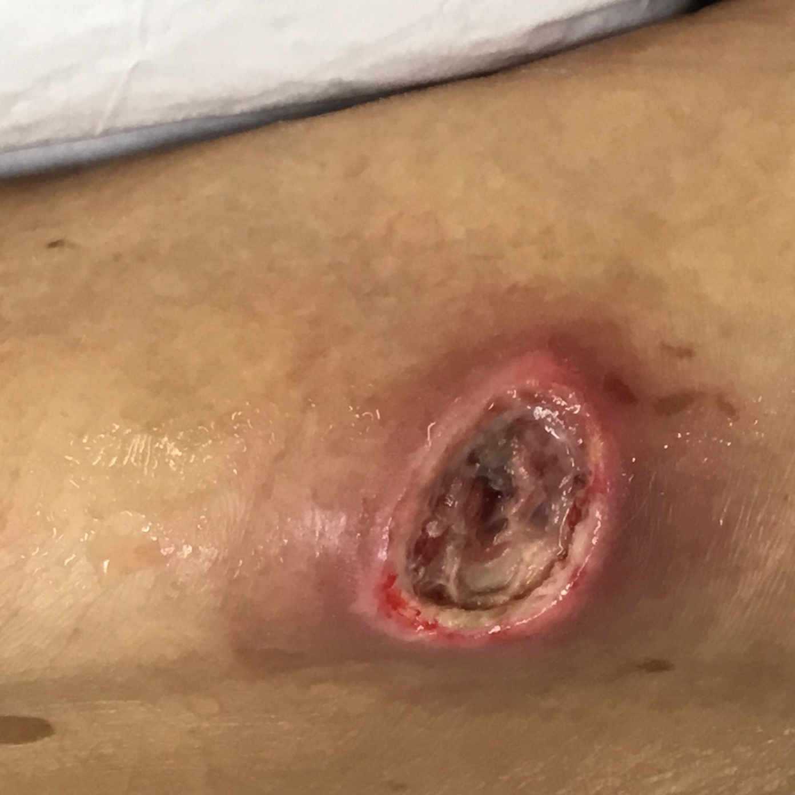
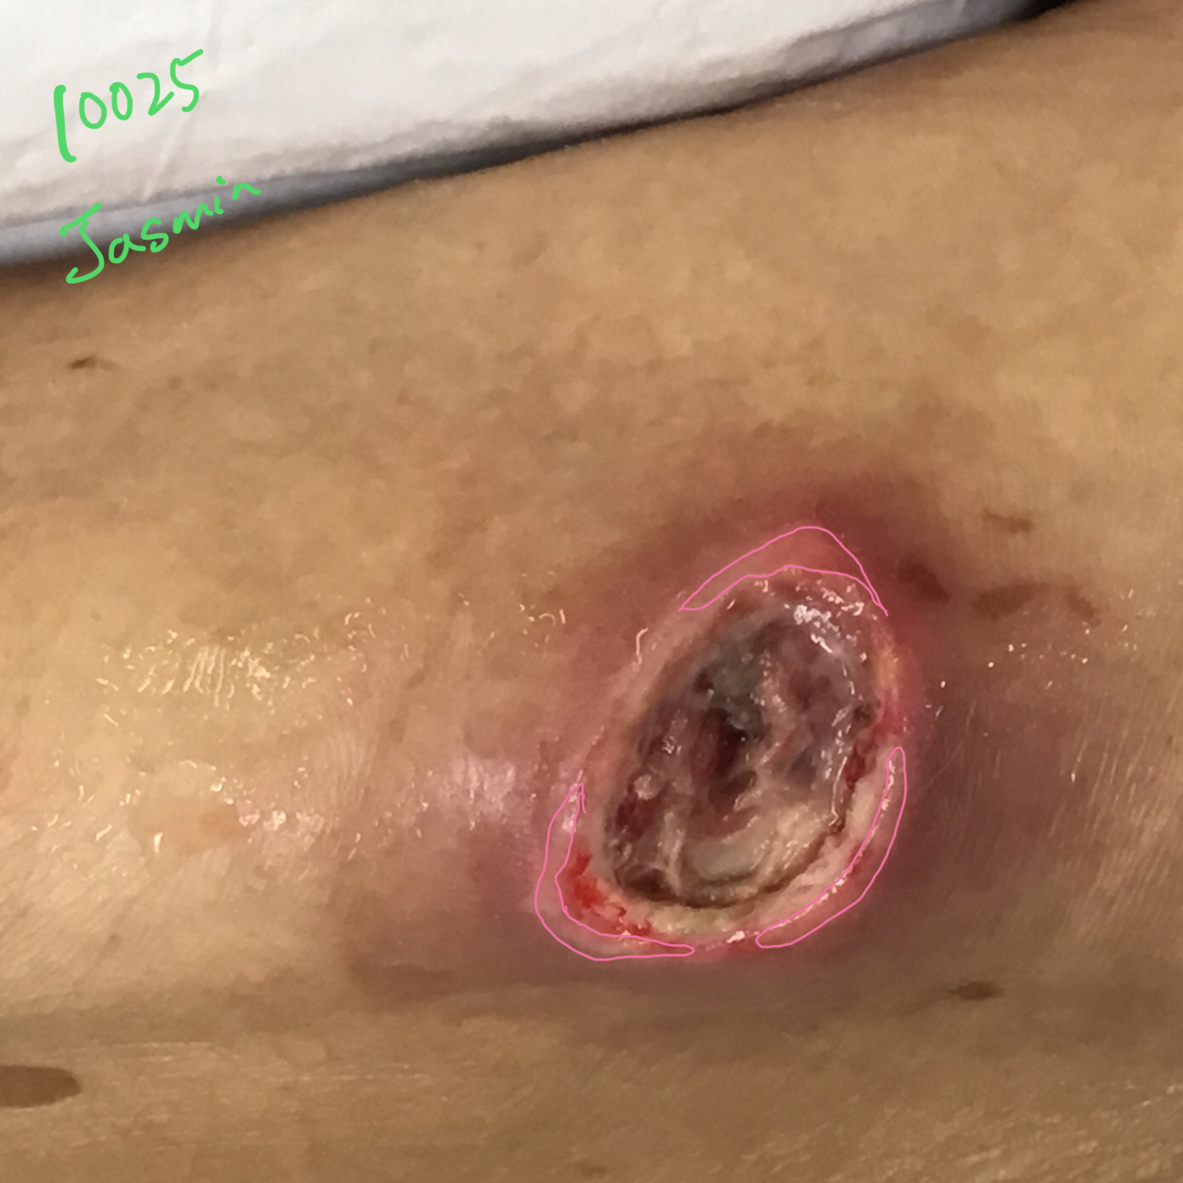
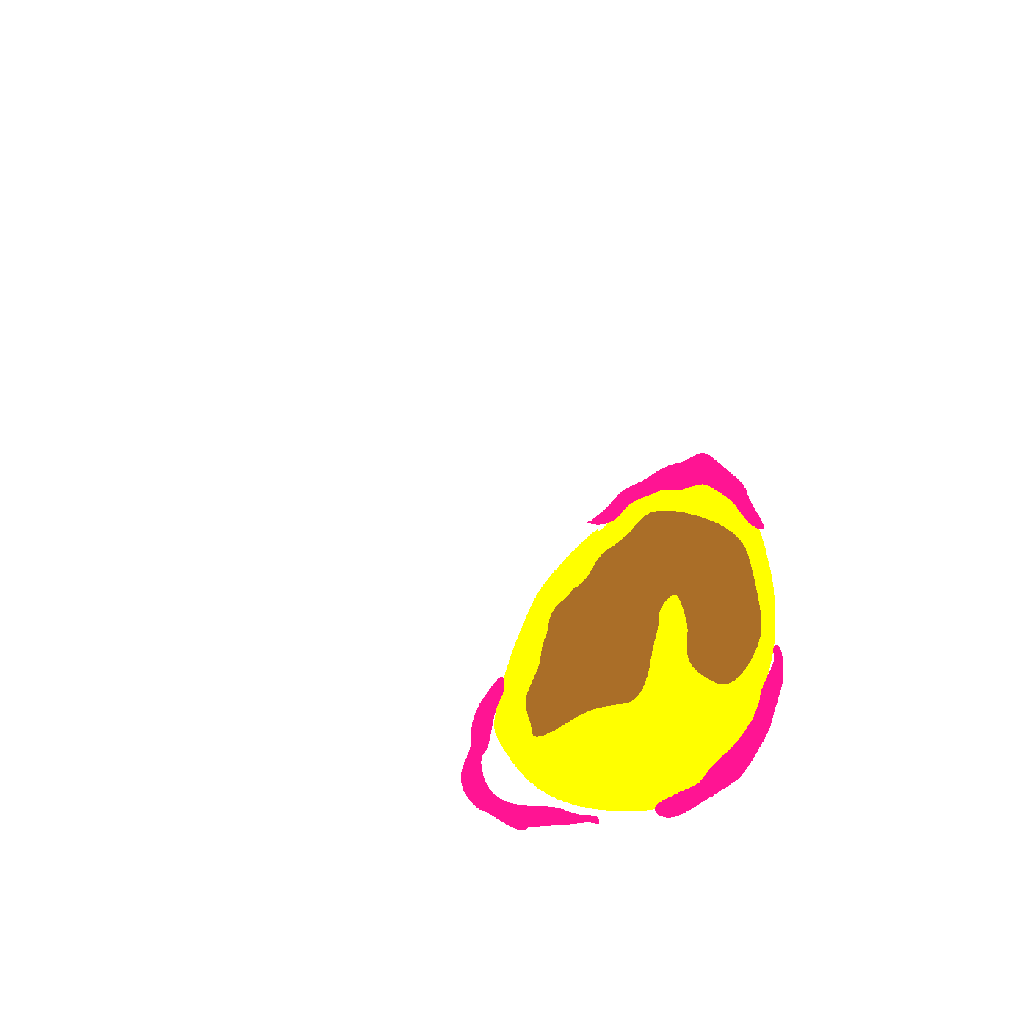
Original Wound Img
Latest Annotation
Original Mask
Metadata Wound Location: Wound Type:

Slide 3
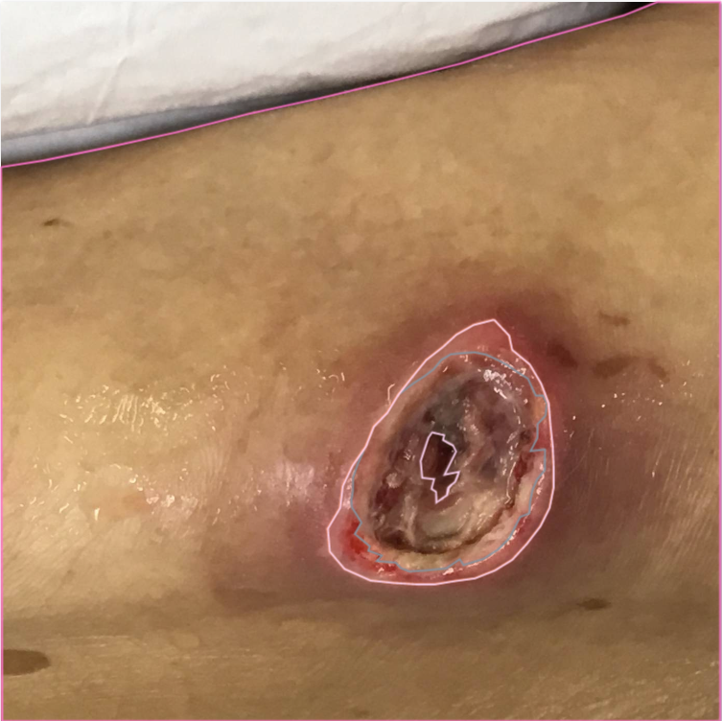
labelled slough because it looks like slough turning necrotic
Notes:
Agreed.

Slide 4
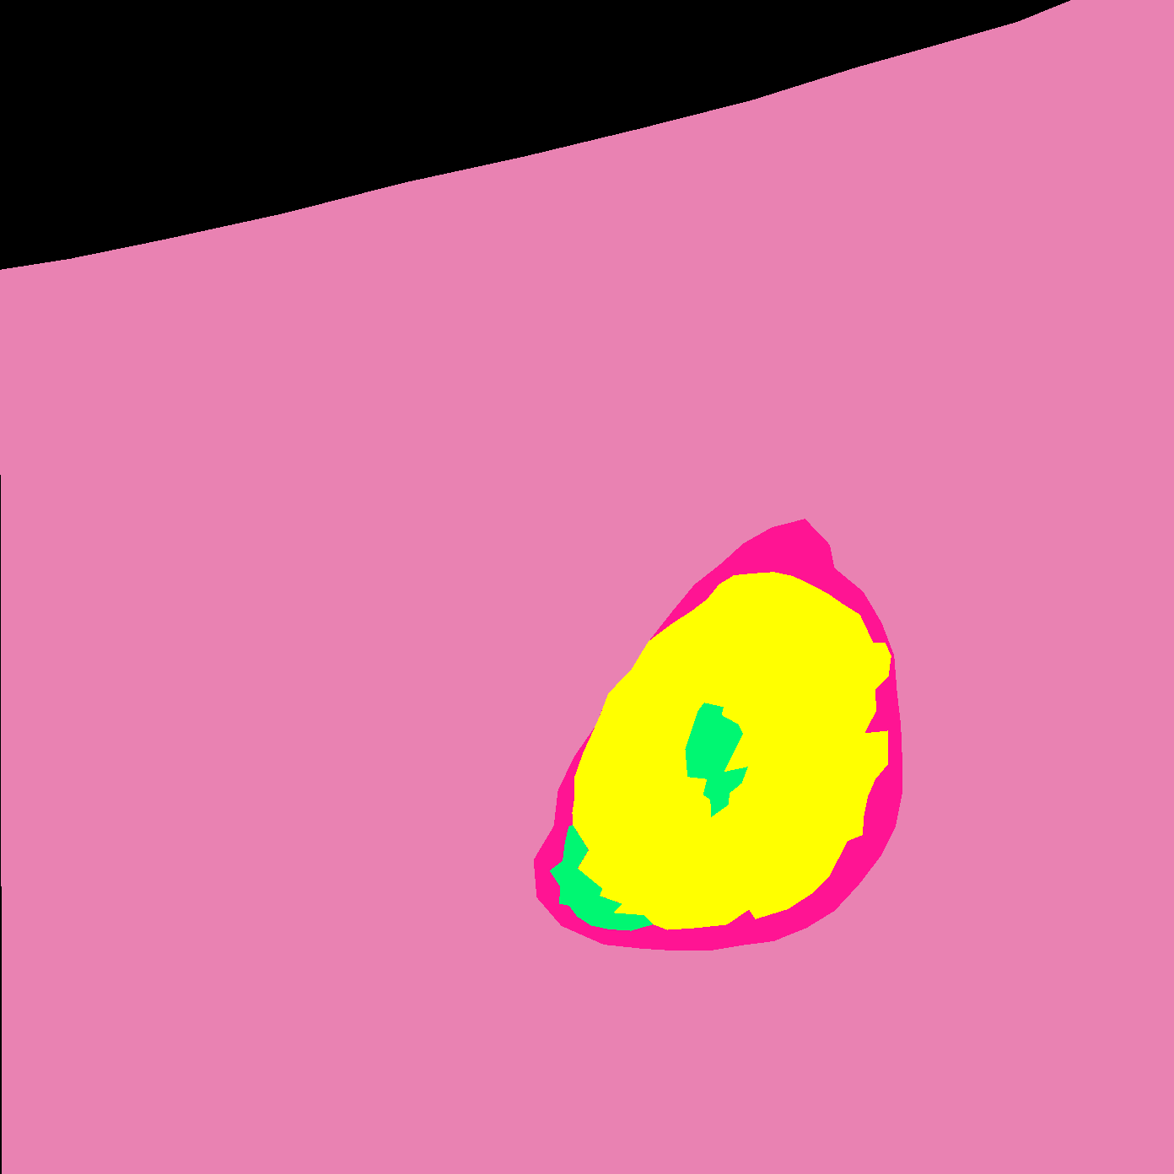
Original Wound Img
New Mask
Original Mask
Notes:
Why healthy granulation in the center?

Slide 5
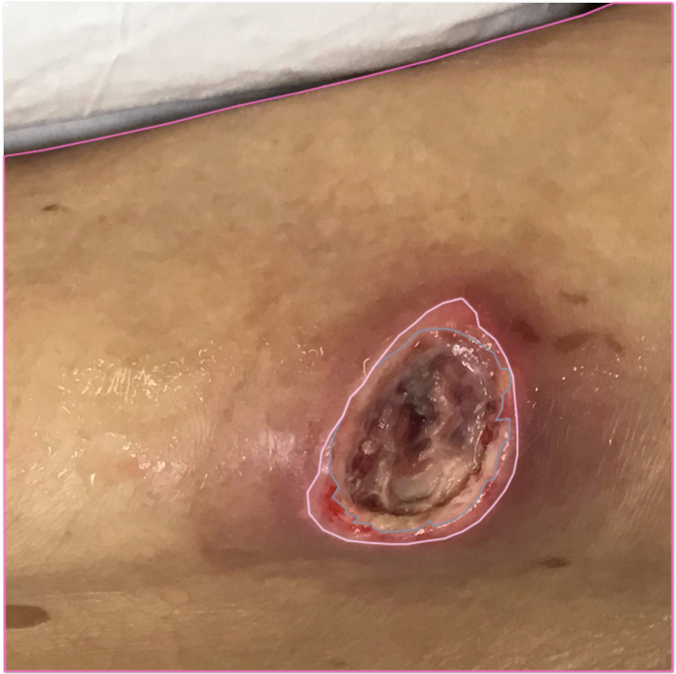

Slide 6

SD: Accepted

